Slide 1
FTP

Slide 2
File Transfer Protocol
Copying a file from one host to another
Problems in FTP
  Two systems may use different file name conventions
  Two systems may have different ways to represent text and data.
  Two systems may have different directory structures.
FTP establishes two TCP connections between client and server.
  One connection is used for data transfer [Port 20]
  Other connection for control information (commands and responses) [Port 21]
  Separation of commands and data transfer makes FTP more efficient. Commands are very simple.

Slide 3
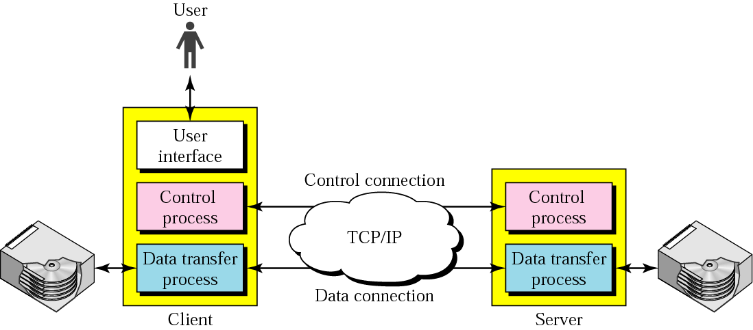
Figure 26.12 FTP
Client has three components
  User interface, Client control process, client data transfer process.
Server has two components
  Server control process, server data transfer process
Control connection is made between control processes; Control connection is maintained during entire interactive FTP session.
Data connection is made between data transfer processes; Data connection is opened & then closed for each file transferred.

Slide 4
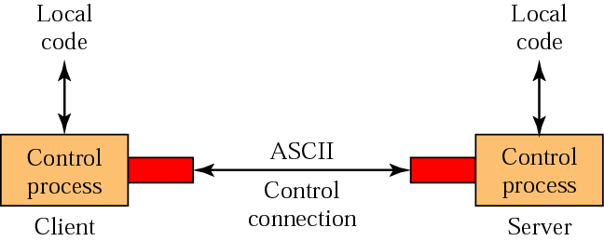
Figure 26.13 Using the control connection
Control Connection
  Created in same way as other application programs.
  Connection remains open during the entire process.
  TOS in IP header is minimize delay, because this is an interactive connection between a user (human) and a server.
  User types commands and expects to receive responses without significant delay.
Data connection
  Opened when data are ready to transfer. Closed when it is not needed.
  TOS in IP header is maximize throughput.

Slide 5
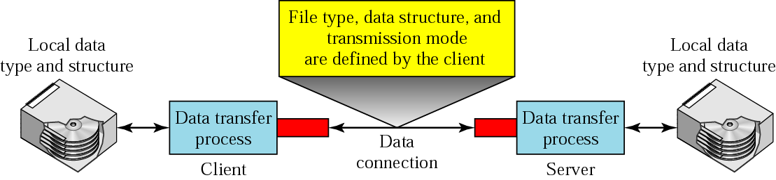
Figure 26.14 Using the data connection
Communication over control connection
  Uses ASCII character set.
  Each command or response is only one short line, so we need not worry about file format or file structure.
  Each line is terminated with a two-character (carriage return and line feed) end-of-line token.
Communication over data connection
  Client must define the type to be transferred, the structure of the data, and the transmission mode.
  Heterogeneity is solved by: file type, data structure, transmission mode.

Slide 6
File type
  ASCII file:
    By default for transferring text files.
    Sender transforms the file from its own representation to ASCII characters
    Receiver transforms the ASCII characters to its own representation.
  Image file
    Default format for transferring binary files
    File is sent as continuous streams of bits without any interpretation or encoding
    Used for compiled programs or images.

Slide 7
Data structure
  FTP can transfer a file across the data connection using one of the following interpretations about structure of data:
    File structure (default)
      File has no structure.
      Continuous stream of bytes
    Record structure
      File is divided into records (or structs in C).
      Used only with text files.
    Page structure
      File is divided into pages, with each page having a page number and a page header.
      Pages can be stored or accessed randomly or sequentially.

Slide 8
Transmission mode: FTP can transfer a file across the data connection by using one of following three transmission modes:
  Stream mode
    Default mode
    Data is delivered from FTP to TCP as a continuous stream of bytes; TCP is responsible for chopping data into segments of appropriate size.
    End-of-file is closing of data connection by sender.
    If data is divided into records, each record will have 1-byte end-of-record (EOR) character, and the end of the file will have a 1-byte end-of-file (EOF) character.
  Block mode
    Data can be delivered from FTP to TCP in blocks.
    Block is preceded by 3-byte header.
    1st byte is called the block descriptor; next 2 bytes defines the size of block in bytes.
  Compressed mode
    If file is big, data can be compressed.
    Commonly used compression method is run-length encoding.
    Consecutive appearance of a data unit are replaced by one occurrence and number of repetitions. Usually, Blanks in text file and null characters in binary file are compressed.

Slide 9
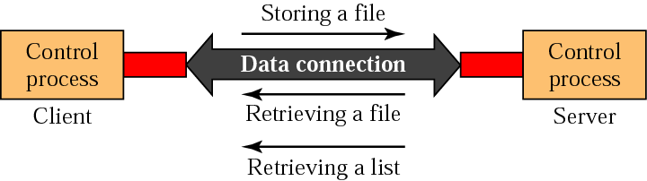
Figure 26.15 File transfer
Means of File Transfer
  Retrieving a file: Copy file from server to client.
  Storing a file: copy file from client to server.
  List of directory or file names is to be sent from the server to the client. Note that FTP treats a list of directory or file names as a file. It is sent over the data connection.

Slide 10
Example 1
Figure 26.16 (next slide) shows an example of how a file is stored.
The control connection is created, and several control commands and responses are exchanged.
Data are transferred record by record.
A few commands and responses are exchanged to close the connection.

Slide 11
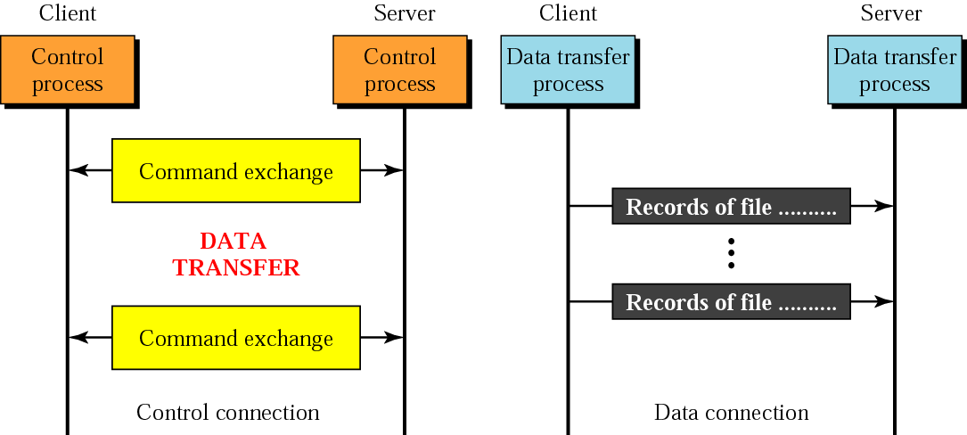
Figure 26.16 Example 1

Slide 12
Table 26.4 List of FTP commands in UNIX
Commands
!, $, account, append, ascii, bell, binary, bye, case, cd, cdup, close, cr, delete, debug, dir, discount, form, get, glob, hash, help, lcd, ls, macdef, mdelete, mdir, mget, mkdir, mls, mode, mput, nmap, ntrans, open, prompt, proxy, sendport, put, pwd, quit, quote, recv, remotehelp, rename, reset, rmdir, runique, send, status, struct, sunique, tenex, trace, type, user, verbose,?

Slide 13
Example 2
We show some of the user interface commands that accomplish the same task as in Example 1. The user input is shown in boldface. As shown below, some of the commands are provided automatically by the interface. The user receives a prompt and provides only the arguments.
$ ftp challenger.atc.fhda.edu
Connected to challenger.atc.fhda.edu
220 Server ready
Name: forouzan
Password: xxxxxxx
ftp > ls /usr/user/report
200 OK
150 Opening ASCII mode
...........
...........
226 transfer complete
ftp > close
221 Goodbye
ftp > quit

Slide 14
Example 3
We show an example of using anonymous [public access OR without an account] FTP. We connect to internic.net, where we assume there are some public data available.
Sometimes, anonymous as user name and guest as password
$ ftp internic.net
Connected to internic.net
220 Server ready
Name: anonymous
331 Guest login OK, send "guest" as password
Password: guest
ftp > pwd
257 '/' is current directory
ftp > ls
200 OK
150 Opening ASCII mode
bin
...
ftp > close
221 Goodbye
ftp > quit

